Slide 1
Apache Spark An overview Cloud Computing (System Algorithms), Microsoft Research

Slide 2
Spark
Agenda
Apache Spark Overview
Concept and Scheduling Mechanism
Other Components Quick Overview

Slide 3
Apache Spark Overview
Agenda
Reports 2015
Overview
Benefits
Performance

Slide 4
What is Hadoop?
Hadoop is a Distributed Framework for Big Data
Created by Doug Cutting and Mike Carafella in 2005.
Cutting named the program (Hadoop) after his son’s toy elephant.
Goals / Requirements:
Abstract and facilitate the storage and processing of large and/or rapidly growing data sets
Structured and un-structured data
Simple programming models
High scalability and availability
Use commodity (cheap!) hardware with little redundancy
Fault-tolerance
Move computation rather than data

Slide 5
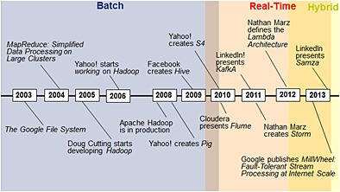
Hadoop Timeline
Reference: https://www.researchgate.net/figure/Big-Data-processing-paradigms-technologies-and-timeline_fig6_266373455

Slide 6
A Typical Hadoop Cluster
Laptop
(Client)
Name Node
Name Node
Head Node
Head Node
Data Node
Data Node
Data Node
Storage
Storage
Storage
Storage
Storage
Storage
Cloud Storage
(e.g. Azure Blob)

Slide 7
HDFS – Hadoop Distributed File System
HDFS splits huge files into small chunks known as data blocks.
We (client and admin) do not have any control over the data block like block location.
Namenode decides all such things
HDFS File (Test1.txt)
Block-1
(128 MB)
Block-2
(128 MB)
Block-3
(128 MB)
Block-4
(128 MB)
10 MB

Slide 8
Interacting with HDFS
Programmatically (using org.apache.hadoop.fs.FileSystem api)
CLI
Login (ssh) to HDInsight Head and use the “Hadoop fs” CLI
hadoop fs –ls /user
hadoop fs –ls wasb://inventory-hdsparktest-datacontainer@hdsparkstorage2.blob.core.windows.net/inv_root
See https://hadoop.apache.org/docs/r2.6.3/hadoop-project-dist/hadoop-common/FileSystemShell.html

Slide 9
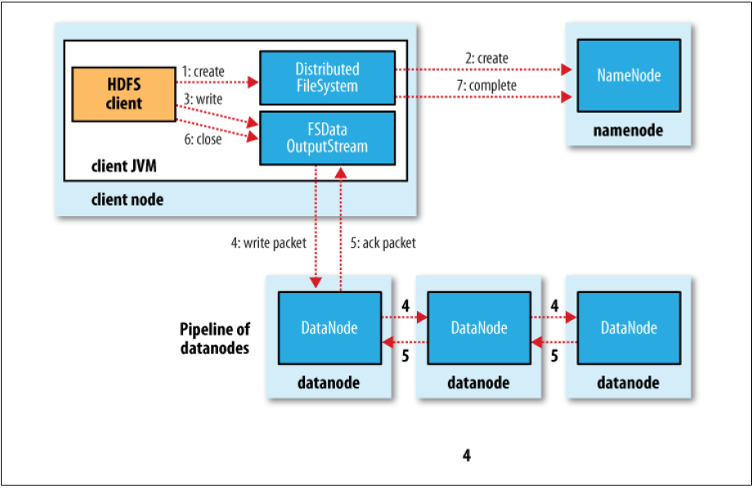
HDFS – Hadoop Distributed File System
Reference: https://community.hortonworks.com/questions/59364/few-questions-on-hadoop-2x-architecture.html

Slide 10
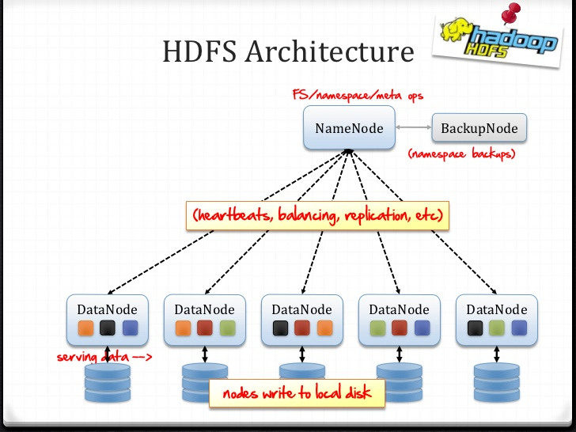
HDFS – Hadoop Distributed File System
Reference: http://dentrodelasala.com/superb-hadoop-architecture-ppt/hadoop-architecture-ppt-on-architecture-for-filenewtemplate/

Slide 11
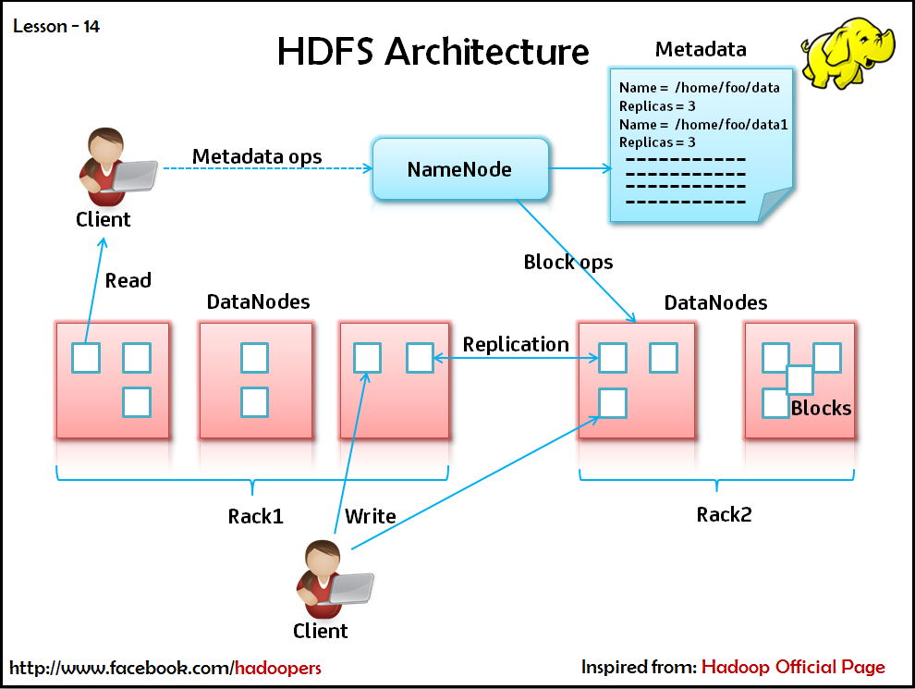
HDFS – Hadoop Distributed File System…
Reference: http://pramodgampa.blogspot.com/2013/08/hdfs-in-detail.html

Slide 12
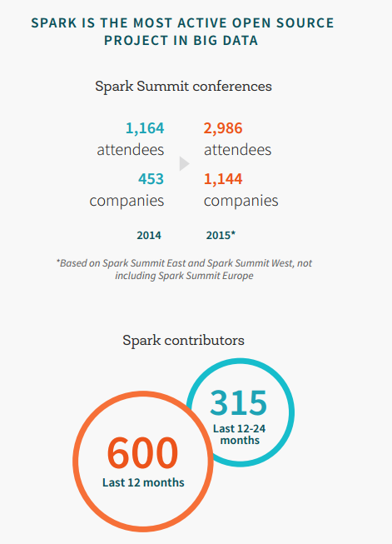
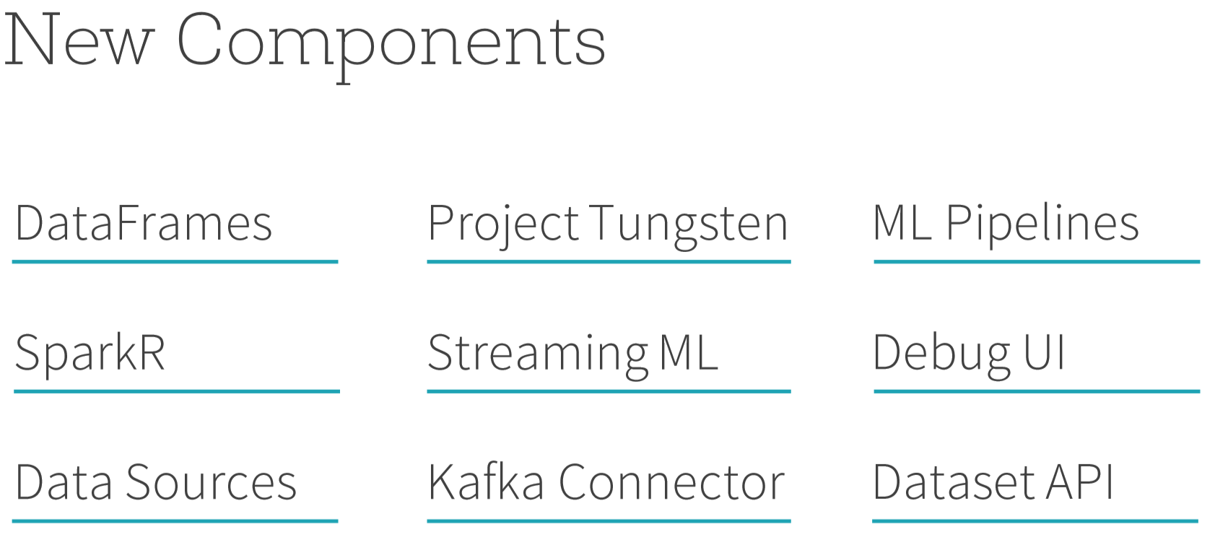
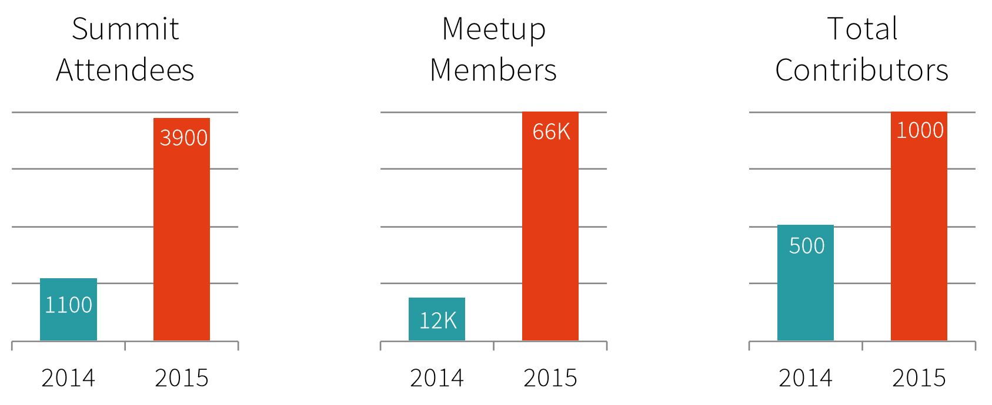
Spark 2015
Ms Inner teams：
Azure
HDInsight
Azure Batch
Bing Ads
SDP Spark team
Office 365
Indexserve
. . .

Slide 13
Apache Spark – an Unified Framework
An unified, open source, parallel, data processing framework for Big Data Analytics
Spark Unifies:
Batch Processing
Real-time processing
Stream Analytics
Machine Learning
Interactive SQL
Spark SQL
Interactive Queries
Spark Streaming
Stream processing
Spark MLlib
Machine Learning
GraphX
Graph Computation
Spark Core Engine
Yarn
Mesos
Standalone Scheduler

Slide 14
Spark - Benefits
Performance
Using in-memory computing, win Sort benchmark at 2014
Developer Productivity
Easy-to-use APIs for processing large datasets. Develop like local.
Unified Engine
A single application can combine all types of processing. SQL, Streaming, ML …
Ecosystem
Platform, lib, language, data source …

Slide 15
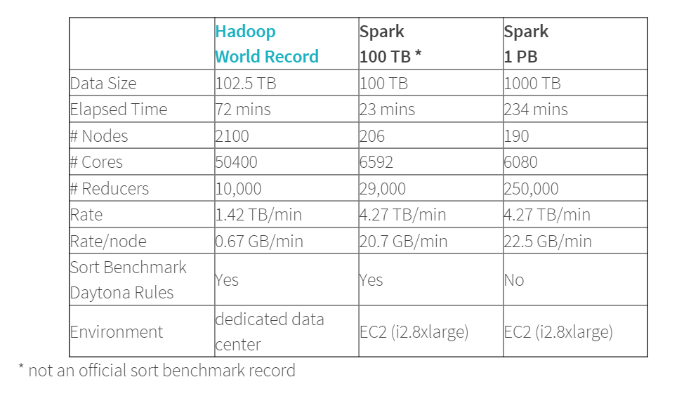

Spark is fast
Spark is the current (2014) Sort Benchmark winner.
3x faster than 2013 winner (Hadoop).
Spark is fast not just for In-Memory but On-Disk computation as well
tinyurl.com/spark-sort

Slide 16

What makes Spark fast?
A Spark job can load and cache data into memory and query it repeatedly (iteratively) much quicker than disk-based systems. Data-sharing between operations is faster as data is in-memory.
Developing: Spark integrates into the Scala programming language, letting you manipulate distributed datasets like local collections.
Data Sharing between Steps of a Job
Read from HDFS
Write to HDFS
Read from HDFS
Write to HDFS
In Traditional MapReduce
Step 1
Step 2
Read from HDFS
In Spark
Step 1
Step 2

Slide 17
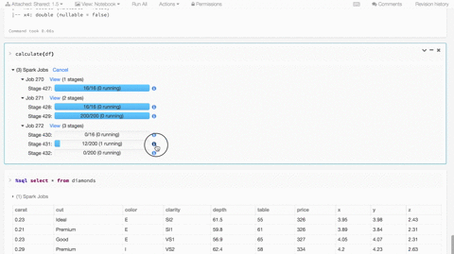
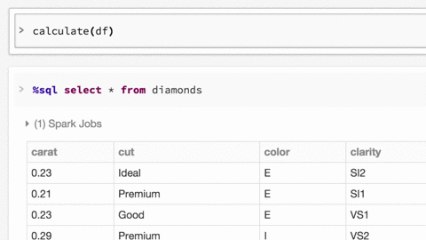
Developer Productivity
Real-time and history Metrics
Interactive and debug

Slide 18
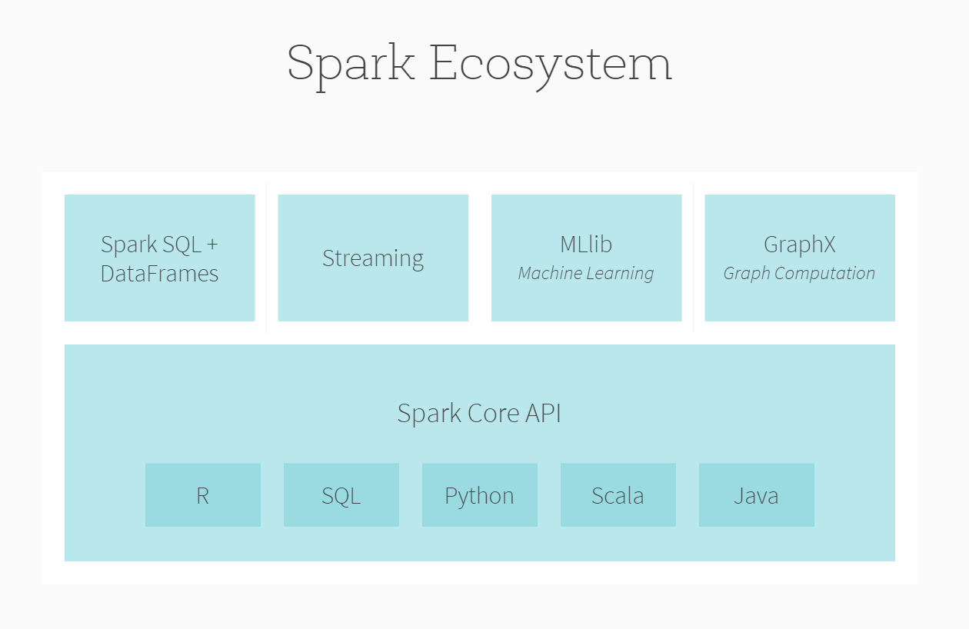
Ecosystem
Diverse System:
Spark on Paddle
Spark SQL on Druid, HBase
Streaming-CEP
Diverse Iib:
>30+ ML libs
Diverse Interface:
Zeppelin, spark notebook …
Tableau …
JDBC, ODBC ..
Diverse Sponsor and vendor:
Data bricks, Cloudera …
MS, IBM …
Alibaba, Baidu …
Diverse connect to other ecosystem:
Java, python, R, C# ecosystem
Database SQL ecosystem
Diverse Platform:
Azure, AWS …
YARN, Mesos …
Docker
Diverse Data Source:
HDFS, HBase …
Azure Storage, AWS …

Slide 19
Concepts
and Scheduling Mechanism
Agenda
Cluster Architecture
RDD
Scheduler

Slide 20

Spark Cluster and Job
Driver
val log = sc.textFile(“hdfs://...”)
val errors = file.filter(_.contains(“ERROR”))
errors.cache()
errors.filter(_.contains(“I/O”)).count()
errors.filter(_.contains(“timeout”)).count()
Action!
Cluster
Manager
Worker
Worker
Worker
Cache1
Cache2
Cache2
Block1
Block2
Block3
Driver

Slide 21
RDD view
Dataset-level view:
Partition-level view:
log:
HadoopRDD path = hdfs://...
block
Filter Transformation
Filter Transformation
errors:
FilteredRDD func = _.contains(…) shouldCache = true
block
Task 1
Task 2
Task 3
Task 4
Node1
Node2
source: https://cwiki.apache.org/confluence/display/SPARK/Spark+Internals

Slide 22
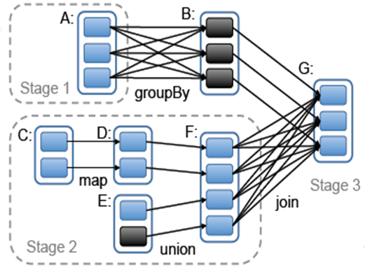
Jobs
Build a DAG according to RDD’s lineage graph
Action
Action
Action
partition
cached partition
RDD
Notes:
调度器根据目标RDD的血统关系图（lineage graph）创建一个由stage构成的无回路有向图（DAG）。每个stage内部尽可能多地包含一组具有窄依赖关系的转换，并将它们流水线并行化（pipeline）。stage的边界有两种情况：一是宽依赖上的混排（shuffle）操作；二是已缓存分区，它可以缩短父RDD的计算过程。
调度器根据数据存放的位置分配任务，以最小化通信开销。如果某个任务需要处理一个已缓存分区，则直接将任务分配给拥有这个分区的节点。否则，如果需要处理的分区位于多个可能的位置（例如，由HDFS的数据存放位置决定），则将任务分配给这一组节点。对于宽依赖（例如需要混排的依赖），目前的实现方式是，在拥有父分区的节点上将中间结果物化（materialize），简化容错处理，这跟MapReduce中物化map输出很像。
如果某个任务失效，只要stage中的父RDD分区可用，则只需在另一个节点上重新运行这个任务即可。如果某些stage不可用（例如，混排时某个map输出丢失），则需要重新提交这个stage中的所有任务来计算丢失的分区。
最后，lookup行为允许用户从一个哈希或范围分区的RDD上，根据关键字读取一个数据元素。这里有一个设计问题。Driver程序调用lookup时，只需要使用当前调度器接口计算关键字所在的那个分区。当然任务也可以在集群上调用lookup，这时可以将RDD视为一个大的分布式哈希表。这种情况下，任务和被查询的RDD之间的并没有明确的依赖关系（因为worker执行的是lookup），如果所有节点上都没有相应的缓存分区，那么任务需要告诉调度器计算哪些RDD来完成查找操作。

Slide 23
Job scheduling
RDD Objects
DAGScheduler
TaskScheduler
Worker
Cluster manager
Threads
DAG
TaskSet
Task
Block manager
rdd1.join(rdd2) .groupBy(…)
.filter(…)
split graph into stages of tasks
launch tasks via cluster manager
execute tasks
submit each stage as ready
retry failed or straggling tasks
store and serve blocks
build operator DAG
source: https://cwiki.apache.org/confluence/display/SPARK/Spark+Internals

Slide 24
Scheduling Strategies
Scheduling between applications:
FIFO strategies
Scheduling within an application:
FIFO or FAIR: Free core is allocated to candidate stages based on FIFO or FAIR.
Delay Scheduling: Each stage will use Delay scheduling strategy select the qualified task
Speculation Scheduling: Scheduler monitor each stage, check the stragglers and migrate it.
Dynamic Allocation

Slide 25
Scheduling
Task launch
Executor
Executor
Executor
Driver
Executor
Executor
Executor
Task completion

Slide 26
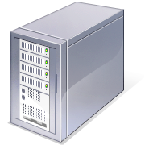
FIFO Scheduling
Job Queue

Slide 27
FIFO Scheduling
Job Queue

Slide 28
FIFO Scheduling
Job Queue

Slide 29
FAIR Scheduling
Scheduler (FIFO)
Problem: short jobs get stuck behind long ones
Separate clusters
Problem 1: poor utilization
Problem 2: costly data replication
Full replication across clusters nearly infeasible
Partial replication prevents cross-dataset queries
Notes:
Just say that a job is composed of multiple tasks

Slide 30
Fair Scheduling
Job Queue

Slide 31
Fair Scheduling
Job Queue

Slide 32
The Problem of Fair Scheduling
Master
Job 1
Job 2
Scheduling order
Task 2
Task 5
Task 3
Task 1
Task 7
Task 4
Slave
Slave
Slave
Slave
Slave
Slave
File 1:
2
3
6
2
5
8
3
5
8
1
4
9
1
7
9
4
6
7
File 2:
1
2
1
3
2
3
Notes:
Say that a job is composed of multiple tasks
Say that job 2 wants to read file 2
- Explain that the little page things are blocks

Slide 33
The Problem of Fair Scheduling
Master
Job 2
Job 1
Scheduling order
Task 4
Task 2
Task 5
Task 1
Task 1
Task 3
Task 3
Task 2
Task 7
Slave
Slave
Slave
Slave
Slave
Slave
File 1:
2
3
6
2
5
8
3
5
8
1
4
9
1
7
9
4
6
7
File 2:
1
2
1
3
2
3
Problem: Fair decision hurts locality
Especially bad for jobs with small input files

Slide 34
Special Instance: Sticky Slots
Under fair sharing, locality can be poor even when all jobs have large input files
Problem: jobs get “stuck” in the same set of task slots
When one a task in job j finishes, the slot it was running in is given back to j, because j is below its share
Bad because data files are spread out across all nodes
Job | Fair Share | Running Tasks
Job 1 | 2 | 2
Job 2 | 2 | 2
Master
Job | Fair Share | Running Tasks
Job 1 | 2 | 1
Job 2 | 2 | 2
Task
Task
Task
Task
Slave
Slave
Slave
Slave
Notes:
Side effect / phenomenon with fair queuing
TODO: Show graph with sticky slots results?

Slide 35
Solution: Delay Scheduling
Relax queuing policy to make jobs wait for a limited time if they cannot launch local tasks
Result: Very short wait time (1-5s) is enough to get nearly 100% locality

Slide 36
Delay Scheduling Example
Wait!
Master
Job 2
Job 1
Scheduling order
Task 1
Task 3
Task 5
Task 8
Task 1
Task 3
Task 2
Task 7
Task 4
Task 2
Task 6
Slave
Slave
Slave
Slave
Slave
Slave
File 1:
2
3
6
2
5
8
3
5
8
1
4
9
1
7
9
4
6
7
File 2:
1
2
1
3
2
3
Idea: Wait a short time to get data-local scheduling opportunities
Notes:
Add “wait” popups above job 2… or show a sliding queue pointer

Slide 37
Delay Scheduling Details
Scan jobs in order given by queuing policy, picking first that is permitted to launch a task
Jobs must wait before being permitted to launch non-local tasks
If wait < T₁, only allow node-local tasks
If T₁ < wait < T₂, also allow rack-local
If wait > T₂, also allow off-rack
Increase a job’s time waited when it is skipped
Notes:
Say that these will be explained next

Slide 38
Speculation Scheduling For Tasks
Nodes slow (stragglers) → run backup tasks
Node 1
Node 2
How to do this in heterogeneous environment?
Notes:
Mention focus on fast finishing time (vs traditional focus on recovery); single straggler slows down entire system, and is costlier on EC2

Slide 39
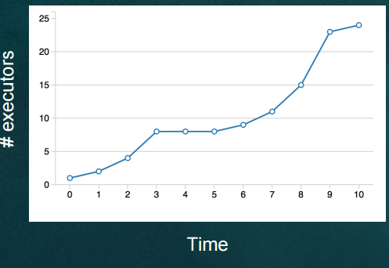
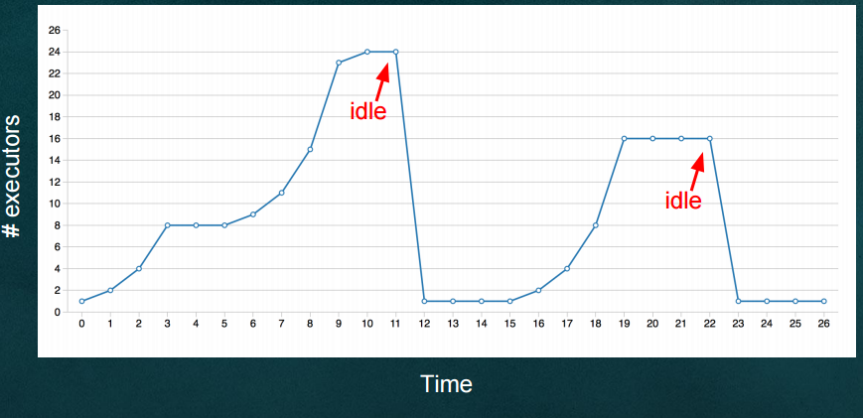
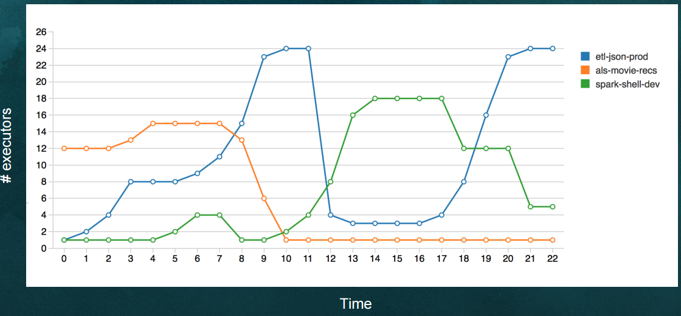
Dynamic Allocation
Allow Spark App to scale resources up and down based on workload. (when idle remove, when need request)
Scale up policy:
Request resources when there are pending tasks.
Scale up in multiple rounds. Exponential increase over time.
Scale down policy:
Remove resources that have been idle for N seconds.

Slide 40
Reference
https://people.csail.mit.edu/matei/talks/2009/hadoop_summit_fair_scheduler.ppt
https://people.csail.mit.edu/matei/talks/2010/eurosys_delaysched.ppt
Spark 2015 survey
https://microsoft.sharepoint.com/teams/GPS_Data_Insight_2015/_layouts/15/WopiFrame.aspx?sourcedoc={D8103978-1460-4A09-B8D5-32E070473E5F}&file=Spark%20on%20HDInsight%20-%20Technical%20Overview1009.pptx&action=default&DefaultItemOpen=1
https://www.eecs.berkeley.edu/~keo/talks/sparrow-spark-summit-talk.pdf
https://people.csail.mit.edu/matei/talks/2008/osdi_late.ppt
http://www.slideshare.net/databricks/dynamic-allocation-in-spark?from_action=save
http://jerryshao.me/architecture/2015/08/22/spark-dynamic-allocation-investigation/

Slide 41
Other Components Quick Overview
Agenda
Spark Streaming
Spark SQL
GraphX
MLlib

Slide 42
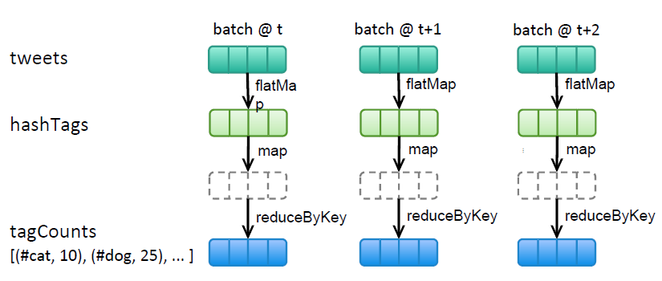
Spark Streaming
Count hashtags in twitter stream over last 10 mins, update every 2 seconds
val tweets = ssc.twitterStream<Twitter username>, <Twitter Password>)
val hashTags = tweets.flatMap (status => getTags(status))
val tagCounts = hashTags.window(Minutes(10), Second(2)).countByValue()
Spark Job
Job Manager
Spark Job
manage
Window Operation
Window Length
Sliding Interval
Callback Operation
Window Operation
Window Length
Sliding Interval
Spark Job
countByValue() is invoked every 2 secs. All RDDs accumulated in the previous 10 mins is passed to the callback function
Spark + Job Manager + Distributed Dataset + Stream API
A Job manager: Receive, separate or combine stream data to generate mini batch spark job, make it possible to process real time or mini batch data
Abstract and manage data to a set of RDD called DStream
Support common stream API

Slide 43
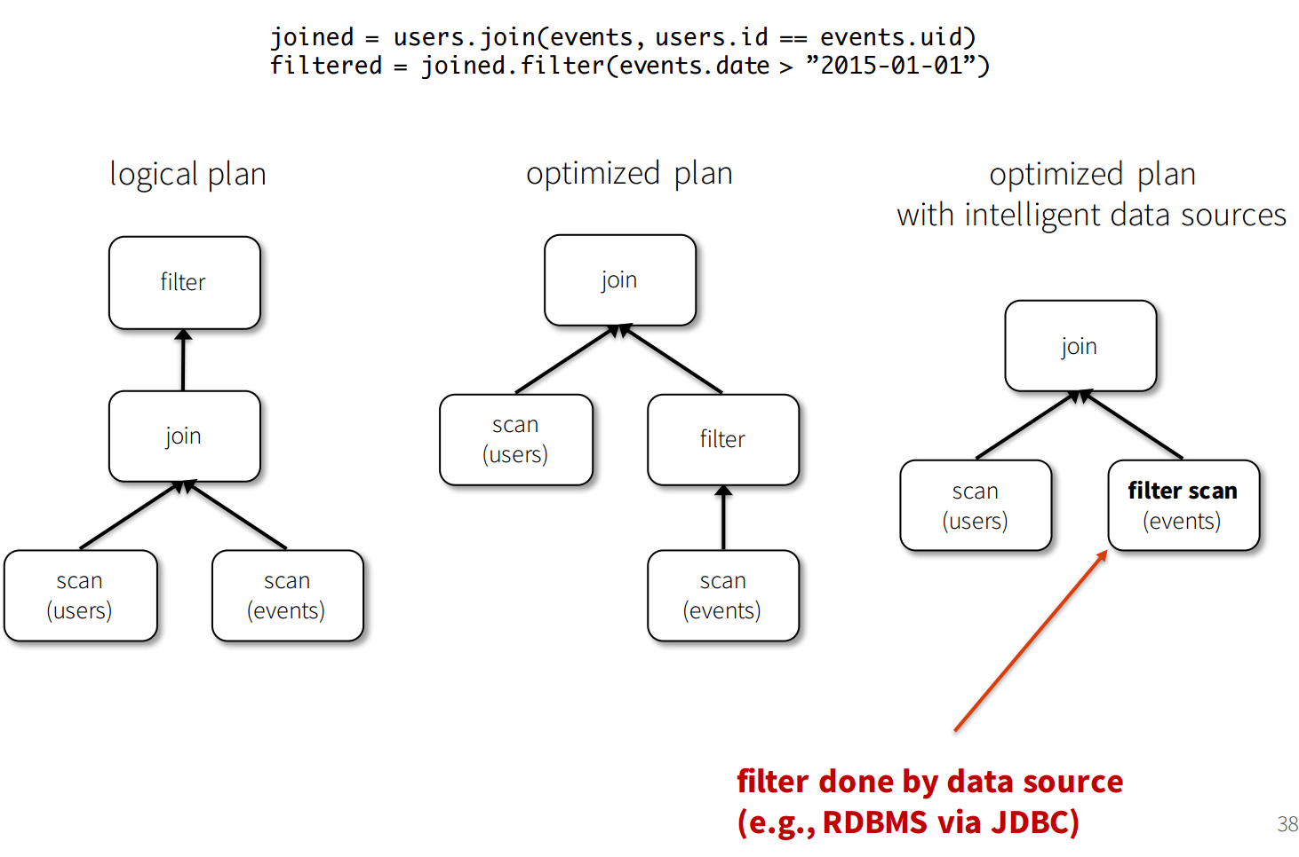
Spark SQL
Translate
SQL
Spark DAG job
Spark + Distributed Schema Dataset + SQL Compiler
Catalyst: Translate SQL and SQL optimization
DataFrames: Is a distributed collection data organized into named columns.
Domain-specific functions designed for common tasks
Metadata
Sampling
Project, filter, aggregation, join …
UDFs
RDDs are collection of ‘Opaque’ objects (i.e. internal structure notknown to Spark)
User
User
User
User
User
User
DataFrames are collection of objects with Schema known to Spark SQL
Name
Age
Sex
Name
Age
Sex
Name
Age
Sex

Slide 44
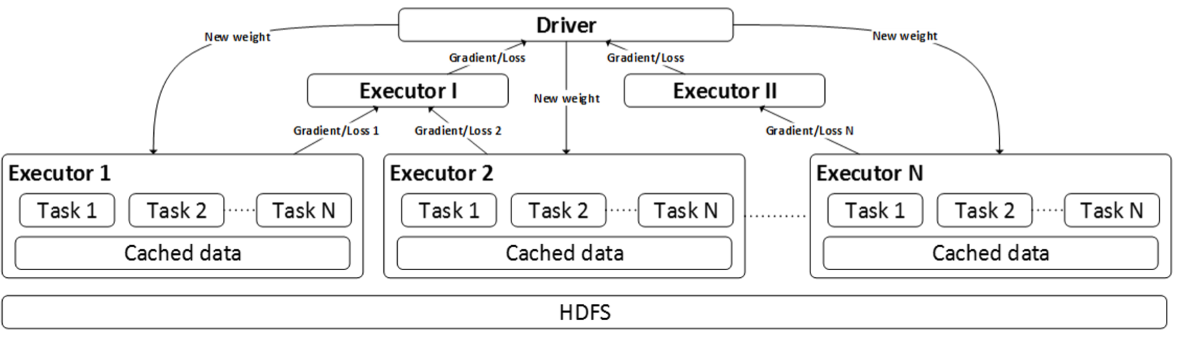
MLlib
Spark + Distributed Matrix Dataset + Matrix API + ML Algorithms
A collection of machine learning algorithms
Integrates with other Spark and open source components
API for Java, Scala or Python

Slide 45
Distributed Graphs as Tables (RDDs)
GraphX
Raw Wikipedia
Hyperlinks
PageRank
Top 20 Pages
< / >
< / >
Spark + Distributed Graph Dataset + Graph API
< / >
HDFS
HDFS
XML
Spark Preprocess
Compute
Spark Post.
Property Graph
Part. 1
Vertex Table (RDD)
Routing
Table (RDD)
Edge Table
(RDD)
B
B
C
C
A
B
A
A
1
2
A
C
A
B
B
1
B
C
A
A
D
D
D
A
D
C
D
Part. 2
C
C
1
D
D
1
2
A
E
F
E
F
E
A
F
E
E
2
E
D
2D Vertex Cut Heuristic
F
F
2
E
F

Slide 46
Thanks!

